Slide 1
Specifications for Version 2:
If you happen to have empty spaces in the building fill them with such building amenities as vending machines, pay phones, etc.
7 apartments (6 tiny studio and 1 small one bedroom);
At least 4 restaurants (1 must be medium);
19 offices;
4 stores;
At least 2 common areas;
8 stories;
2 stories lobby;
Elevators in all above ground levels,
Emergency stair case;
Water and electricity for all levels;
Revenue +500/day;
At least 2 recycling bins;
Apartment building in the upper level floors;
Stores in the lower level floors;
This version of the building to be completed by students N to Z

Slide 2
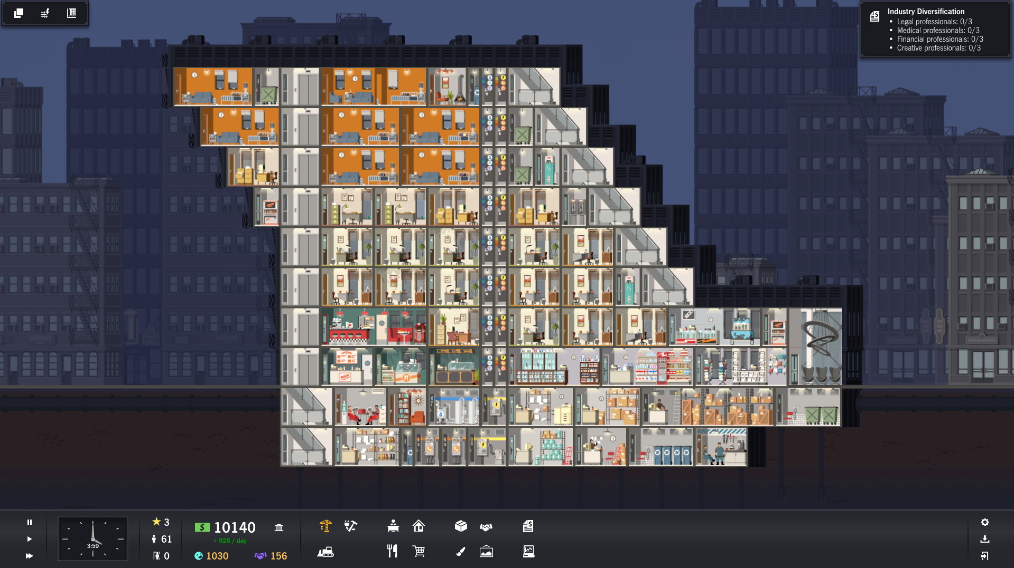
Version 2

Slide 3
Main facilities:
Apartments;
Restaurants;
Offices;
Stores;
Common areas;
Recycling bins;
Amenities – payphones, wending machines, shoe polishing
Plumbing and wiring closets
Garbage bins
Version 2
Supporting services and amenities:
Garbage collection point;
Construction office;
Water meter;
Electrical transformer;
Phone switchboard;
Bottled water;
Copy Center;
Courier;
Store Room;
Recycling room;
Maintainers room;
Movers Office;
Office supplies.
Lobby
2.
3.
4.
7.
8.
9.
1.
13.
5.
5.
4.
6.
12.
10.
11.

